Slide 1
MONKEYPOX ANALYSIS WORLDWIDE
BY:-
PRIYA KUMARI

Slide 2

PRESENTATION OUTLINE
PROBLEM STATEMENT
INTRODUCTION
DATA SUMMARY
METHODOLOGY
EDA
DATA PROCESSING
CHALLENGES
CONCLUSION
REFRENCES

Slide 3
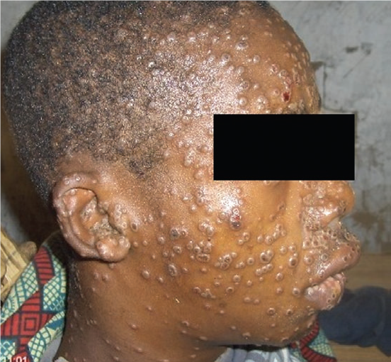
PROBLEM STATEMENT
This project is aimed at predicting the increasing number of cases of the new virus called MonkeyPox which threatens for an outbreak
Our job as Data Scientist is to help identify the important symptoms and the various other variables that contribute to its outbreak and this epidemic stops before turning into a pandemic.

Slide 4
INTRODUCTION
Human monkeypox is a zoonotic Orthopoxviral with a presentation similar to smallpox. Clinical differentiation of the disease from smallpox and varicella is difficult. Laboratory diagnostics are principal components to identification and surveillance of disease, and new tests are needed for a more precise and rapid diagnosis. The majority of human infections occur in Central Africa, where surveillance in rural areas with poor infrastructure is difficult but can be accomplished with evidence-guided tools and educational materials to inform public health workers of important principles. Contemporary epidemiological studies are needed now that populations do not receive routine smallpox vaccination. New therapeutics and vaccines offer hope for the treatment and prevention of monkeypox; however, more research must be done before they are ready to be deployed in an endemic setting. There is a need for more research in the epidemiology, ecology, and biology of the virus in endemic areas to better understand and prevent human infections.

Slide 5
TECHNOLOGY USED

Slide 6

EXPLORING THE DATASET

Slide 7

DATA SUMMARY
MONKEYPOX_DATA, indicating countrywise spread
MONKEYPOX_DATA1, indicating symptoms and hospitalized patients
MONKEYPOX_DATA_CASES, crunch of countries, gender, travel history and symptoms, Cases confimed and suspected

Slide 8
FEATURES
SYMPTOMS( INDEPENDENT VARIABLE)
COUNTRIES
TRAVEL HISTORY YES
TRAVEL HISTORY NO
HOSPITALISED Y/N
DATE OF CONFIRMATION
CONFIRMED CASES
SUSPECTED CASES

Slide 9

METHODOLOGY

Slide 10
APPROACH
DATA PREPARATION
EXPLORATORY DATA ANALYSIS
DRAWING INSIGHTS BASED ON INDEPENDENT VARIABLE ie SYMPTOM AND VARIOUS DEPENDENT VARIABLES ie TRAVEL HISTORY, HOSPITALISATION, CONFIRMED AND SUSPECTED CASES.

Slide 11

EDA
Exploratory Data Analysis is a process of examining or understanding the data and extracting insights or main characteristics of the data. EDA is generally classified into two methods, i.e. graphical analysis and non-graphical analysis.
Exploratory data analysis was promoted by John Tukey to encourage statisticians to explore data, and possibly formulate hypotheses that might cause new data collection and experiments. EDA focuses more narrowly on checking assumptions required for model fitting and hypothesis testing. It also checks while handling missing values and making transformations of variables as needed. Filling the counts with EDA build a robust understanding of the data, issues associated with either the info or process. it’s a scientific approach to get the story of the data.

Slide 12
Exploratory Data Analysis
Technically, The primary motive of EDA is to
Examine the data distribution
Handling missing values of the dataset(a most common issue with every dataset)
Handling the outliers
Removing duplicate data
Encoding the categorical variables
Normalizing and Scaling

Slide 13
STEPS INVOLVED IN EDA
Step 1
First, we will import all the python libraries that are required for this, which include NumPy for numerical calculations and scientific computing, Pandas for handling data, and Matplotlib and Seaborn for visualization.
Step 2
Then we will load the data into the Pandas data frame.
Step 3
We can observe the dataset by checking a few of the rows using the head() method, which returns the first five records from the dataset.
Step 4
Using shape, we can observe the dimensions of the data.

Slide 14
CONTD…
Step 5
info() method shows some of the characteristics of the data such as Column Name, No. of non-null values of our columns, Dtype of the data, and Memory Usage. From this, we can observe, that the data which we have doesn’t have any missing values. We are very lucky in this case, but in real-life scenarios, the data usually has missing values which we need to handle for our model to work accurately. (Note – Later on, I’ll show you how to handle the data if it has missing values in it.
Step 6
We will use describe() method, which shows basic statistical characteristics of each numerical feature (int64 and float64 types): number of non-missing values, mean, standard deviation, range, median, 0.25, 0.50, 0.75 quartiles.
Step 7
Handling missing values in the dataset. Luckily, this dataset doesn’t have any missing values, but the real world is not so naive as our case. So I have removed a few values intentionally just to depict how to handle this particular case. We can check if our data contains a null value or not by the following command So, now we can handle the missing values by using a few techniques, which are
Drop the missing values – If the dataset is huge and missing values are very few then we can directly drop the values because it will not have much impact.
Replace with mean values – We can replace the missing values with mean values, but this is not advisable in case if the data has outliers.
Replace with median values – We can replace the missing values with median values, and it is recommended in case if the data has outliers.
Replace with mode values – We can do this in the case of a Categorical feature.
Regression – It can be used to predict the null value using other details from the dataset.

Slide 15
CONTD…
Step 8
We can check for duplicate values in our dataset as the presence of duplicate values will hamper the accuracy of our ML model. We can remove duplicate values using drop_duplicates()
Step 9
Normalizing and Scaling – Data Normalization or feature scaling is a process to standardize the range of features of the data as the range may vary a lot. So we can pre-process the data using ML algorithms. So for this, we will use StandardScaler for the numerical values, which uses the formula as x-mean/std deviation.
Step 10
Now, using Seaborn, we will visualize the relationships using LINE plot.

Slide 16

DATA PREPROCESSING

Slide 17
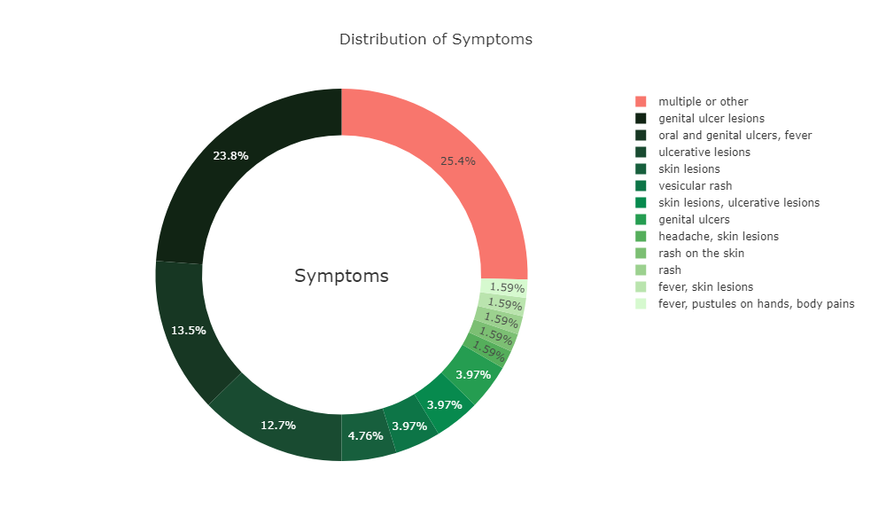
ANALYSIS OF INDEPENDENT VARIABLE: SYMPTOMS

Slide 18
FEATURE SCALING shows Symptoms as the most important feature. From the pie chart we conclude Genital ulcer lesion as the top symptom for Monkeypox

Slide 19
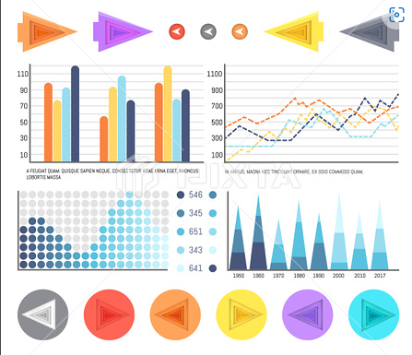
ANALYSIS OF DEPENDENT VARIABLES

Slide 20
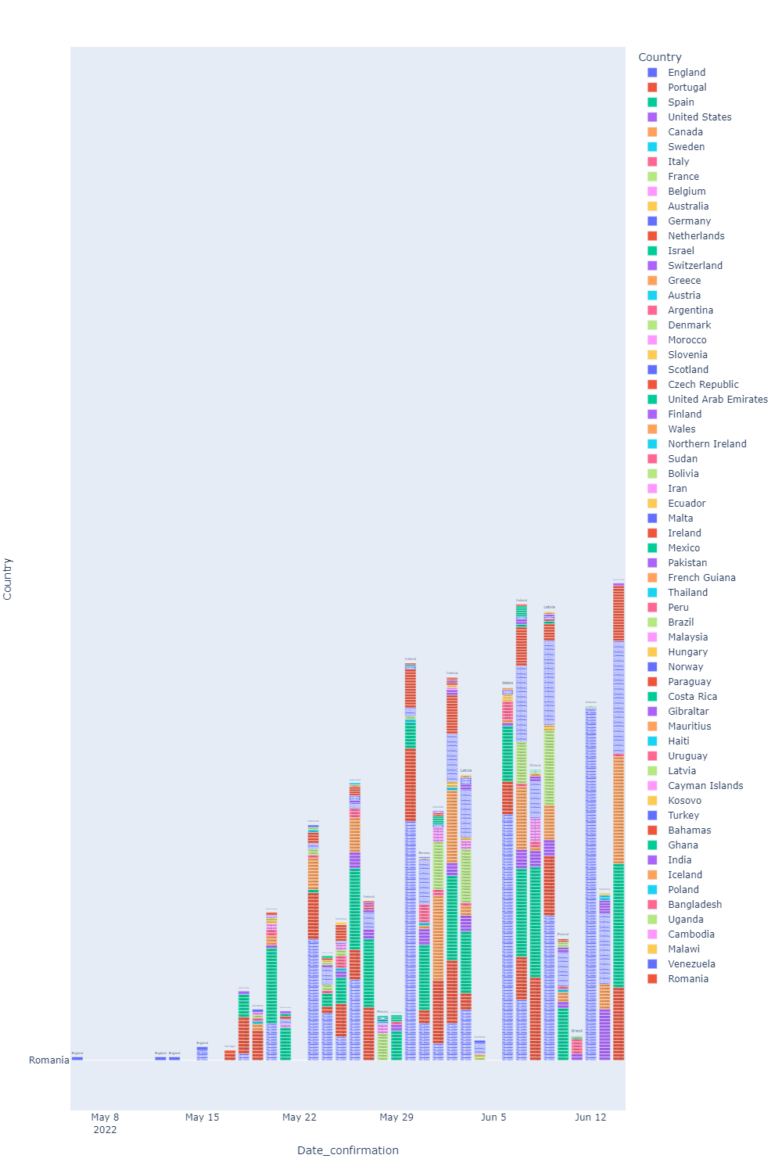
COUNTRY vs CONFIRMATION DATE

Slide 21
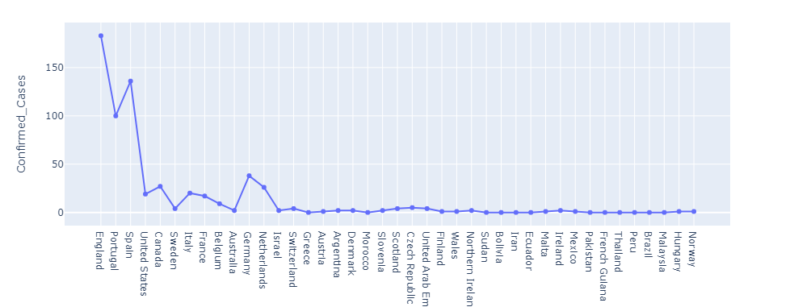
COUNTRY vs CONFIRMED CASES
ENGLAND has highest number of confirmed cases ie 180. no confirmed cases in SUDAN, IRAN, MALTA, BRAZIL, PAKISTAN,EQUADOR, MALAYSIA & PERU.

Slide 22
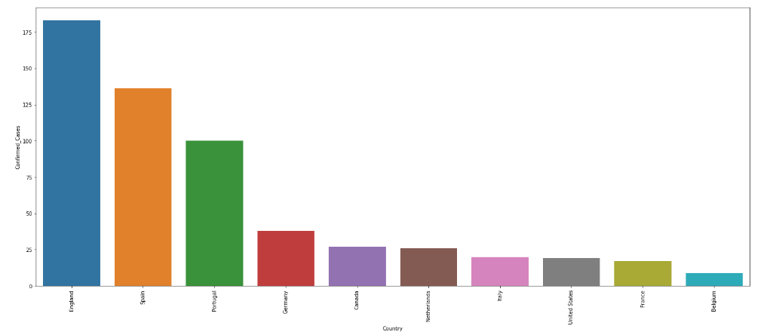
REPRESENTING FIRST 10 COUNTRIES WITH HIGHEST NO OF CONFIRMED CASES

Slide 23
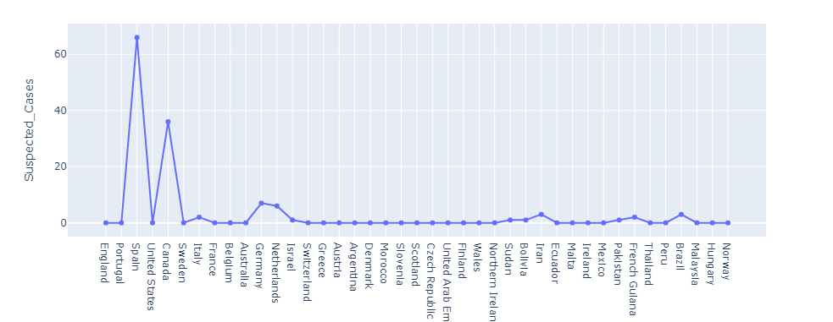
COUNTRY vs SUSPECTED CASES
Maximum number of Suspected cases is in SPAIN being 68 to be specific.

Slide 24
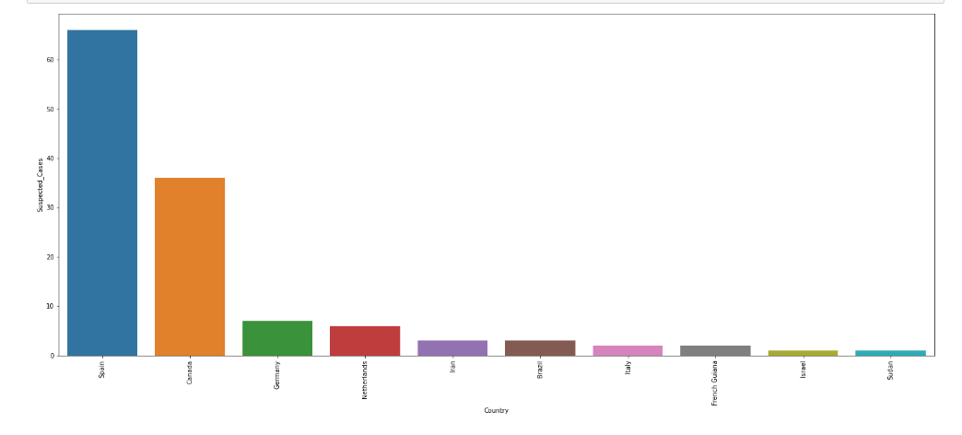
FIRST 10 COUNTRIES WITH SUSPECTED CASES

Slide 25
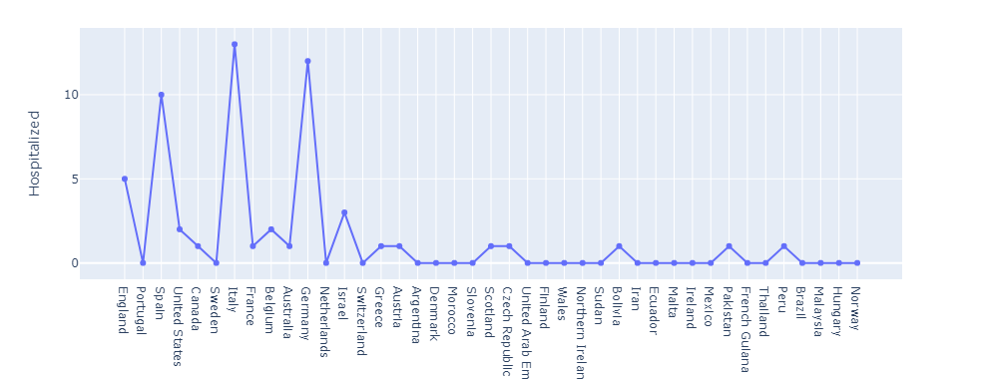
COUNTRY vs HOSPITALIZED PATIENTS
GERMANY & ITALY have maximum number of Hospitalized patients.

Slide 26
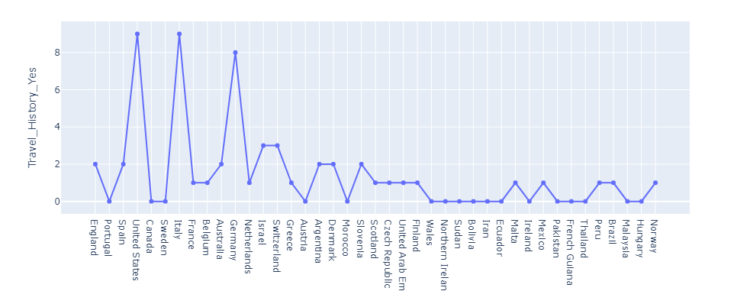
COUNTRY vs WITH TRAVEL HISTORY
ITALY, USA & GERMANY have maximum number of patients with Travel History 9,9,8 respectively.

Slide 27
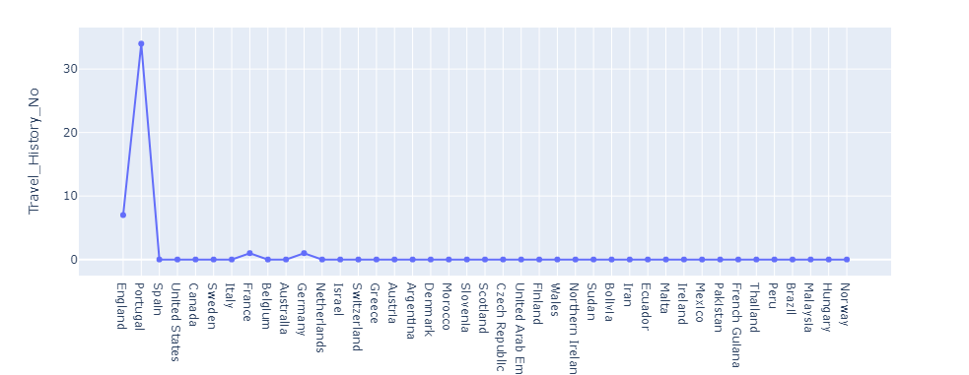
COUNTRY vs NO TRAVEL HISTORY
PORTUGAL has 34 patients with no travel history.

Slide 28
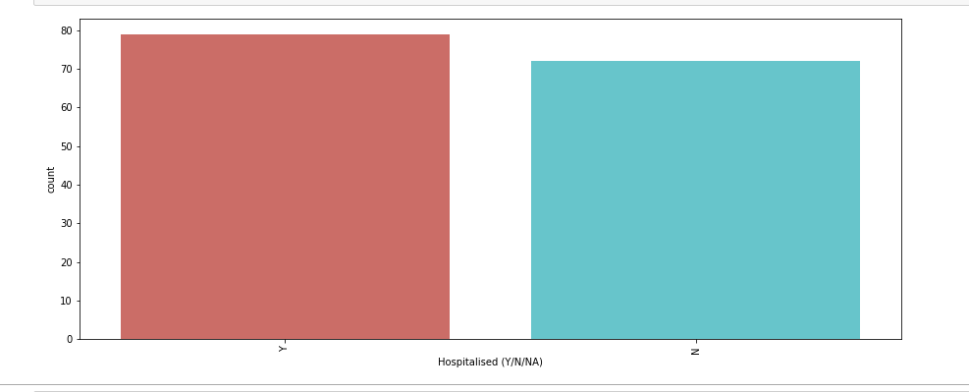
ANALYSIS OF HOSPITALISED PATIENTS YES/NO
As we can see that both classes are not in proportion and we have imbalanced dataset
Y- hospitalized 79
N- not hospitalized 72
Y DATA OUTNUMBERS N DATA out of the total number of people showing symptoms.

Slide 29
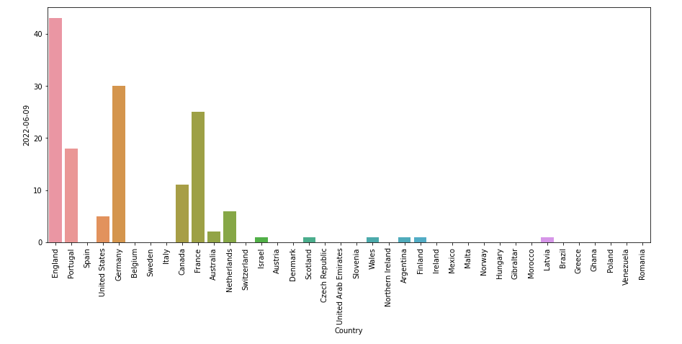
INSIGHTS OF A DATE CHOSEN AT RANDOM, here I chose 09-06-2022

Slide 30
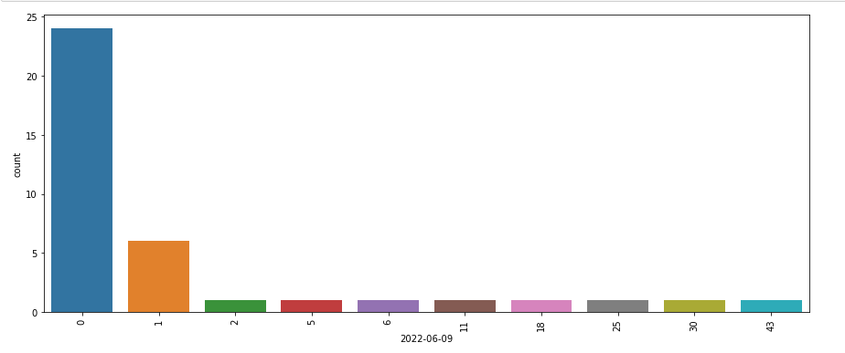
A crisp view

Slide 31
INFERENCE
# # Insights from daily cases dataset as on 9th June 2022
# England being the leader in number of active cases and the number being 43
# Germany has recorded the second highest number of cases; 30.
# # Some General comparative insights which we can get from above plots is:
# 1. England having most number of confirmed cases(183), have very less number of suspected cases(5) which is weird as being near to the most contaminated area increases the risk of suspection of the disease, but here there is not more than 5 suspected case. On the other hand Spain being 2nd on the highest number of confirmed cases has the most number of suspected cases recorded(68).

Slide 32
INFERENCE CONTD.
# 2. Also Canada have the second most number of suspected cases i.e. 35, but is on 5th number when it comes to Confirmed cases. So this is probably a good sign as the cases with suspection can take precautions and have a early cure, also it can be said that people there are more aware and are one more positive side of treatment as if they had seen any sign on MonkeyPox they went to the Hospital to report it.
# 3. There is a less need for hospitalization of the MonkeyPox cases in England, the most affected country, as only 5 cases have been hospitalized till now. On the other hand Gremany and Italy are seeing the most number of hospitalized cases as it has 13 and 14 respectively patients in hospital out of 38 and 20 confirmed cases respectively.
# 4. Italy and USA have most number of cases with travel history 9 and 9 each, approximately 50% of cases have travel history in their records and similar number of patients have been hospitalized; Italy, 12 and USA, 10; confirmed cases being 20 in Italy and 19 in USA. So condition in Italy is a bit severe as more than 50% of patients are in hospitals. (12 out of 20).

Slide 33
CHALLENGES FACED
The data was huge and was to be handled keeping in mind that no point is missed, even if of little relevance.
Computation time.
Carefully handling feature imbalanced data.

Slide 34
FURTHER SCOPE
Computing and getting higher accuracy model using Machine Learning Algorithm.
Tuning of Hyperparameters carefully.
Feature Engineering.

Slide 35
CONCLUSION
Improved surveillance and response, raise awareness of the disease and avoid contact with wild animals, especially monkeys.
Any animals that might have come into contact with an infected animal should be quarantined, handled with standard precautions and observed for monkeypox symptoms for 30 days.
It is important to refocus attention on other diseases. There is a drop in the number of reported cases of endemic diseases as people are not seeking care in health facilities, owing to Covid-19.
So to understand Monkeypox virus composition and develop vaccines and analyse the number of increasing cases EDA will be helpful.

Slide 36
REFERENCES
https://academic.oup.com/cid/article/58/2/260/335791 on 15th June 2022
www.drishtiias.com/monkeypox-data
www.analyticsvidya.com
Python.org
www.kaggle.com (dataset on 14thJune, 2022.)

Slide 37


THANK YOU

